Slide 1

Jackson Baimel, Shankar Palanickal, Chris Kay

Slide 2
What is Ecotopia?
Ecotopia is an innovative web app that connects consumers with eco-friendly businesses
It offers a user-friendly platform for finding and rating businesses based on their sustainability practices, including waste management, ethical sourcing, and green initiatives
In addition to being able to view and rate businesses, consumers can connect and post about their experiences at any business in their community
Notes:
Ecotopia allows users to share tips and recommendations, discuss sustainability topics, and engage in conversations about the businesses they visit
This social aspect not only enhances the user experience but also encourages businesses to continuously improve their practices and connect with their customer base

Slide 3
Why Ecotopia?
We decided to create Ecotopia to create a unique and different social media platform that acts similarly to Twitter but focuses on your local area, specifically on local businesses and their sustainability efforts
Unlike mainstream platforms, Ecotopia integrates local businesses into its ecosystem, empowering users to support and engage with businesses while contributing to climate conscious efforts and economic growth of their communities

Slide 4
Core Features
Creating a profile
Posting reviews
Climate news feed
Search for businesses
Search for users
Local area map

Slide 5
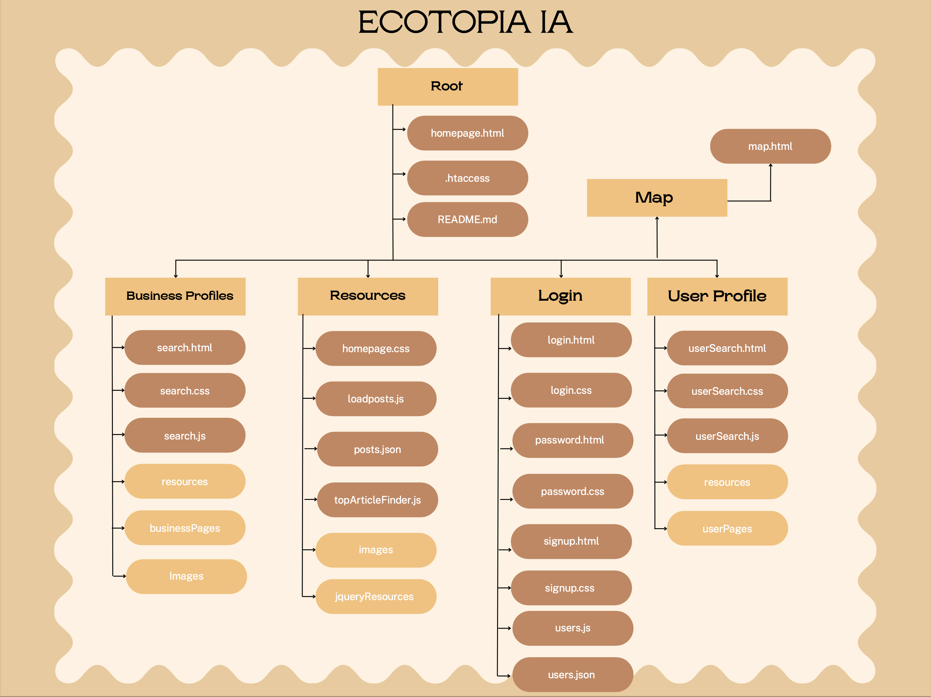

Slide 6

Who uses Ecotopia?
Socially Conscious Consumers: People who value social responsibility and want to support businesses that engage in climate conscious actions
Community Advocates: Users who are passionate about keeping their communities safe and green, while connecting them with like-minded individuals in their area
Environmentalists: Users who prioritize environmental sustainability and want to engage in discussions, share their opinions, and take-action on eco-friendly practices
Small Business Owners: Local businesses looking to connect with potential customers, promote their products or services, and engage with their community will see Ecotopia as an opportunity to strengthen their presence, support their growth, and increase eco-friendly practices
Notes:
Ecotopia would be used by a wide array of people, ranging from everyday consumers to business owners looking to make their business more climate friendly
Some of our main users would be socially conscious consumers, community advocates, enivronmentalists or people (younger) who would love to patronize businesses that place an emphasis on being climate friendly
Other users would be local business or small company owners, who would love to connect with the increasingly larger eco conscious consumer base

Slide 7
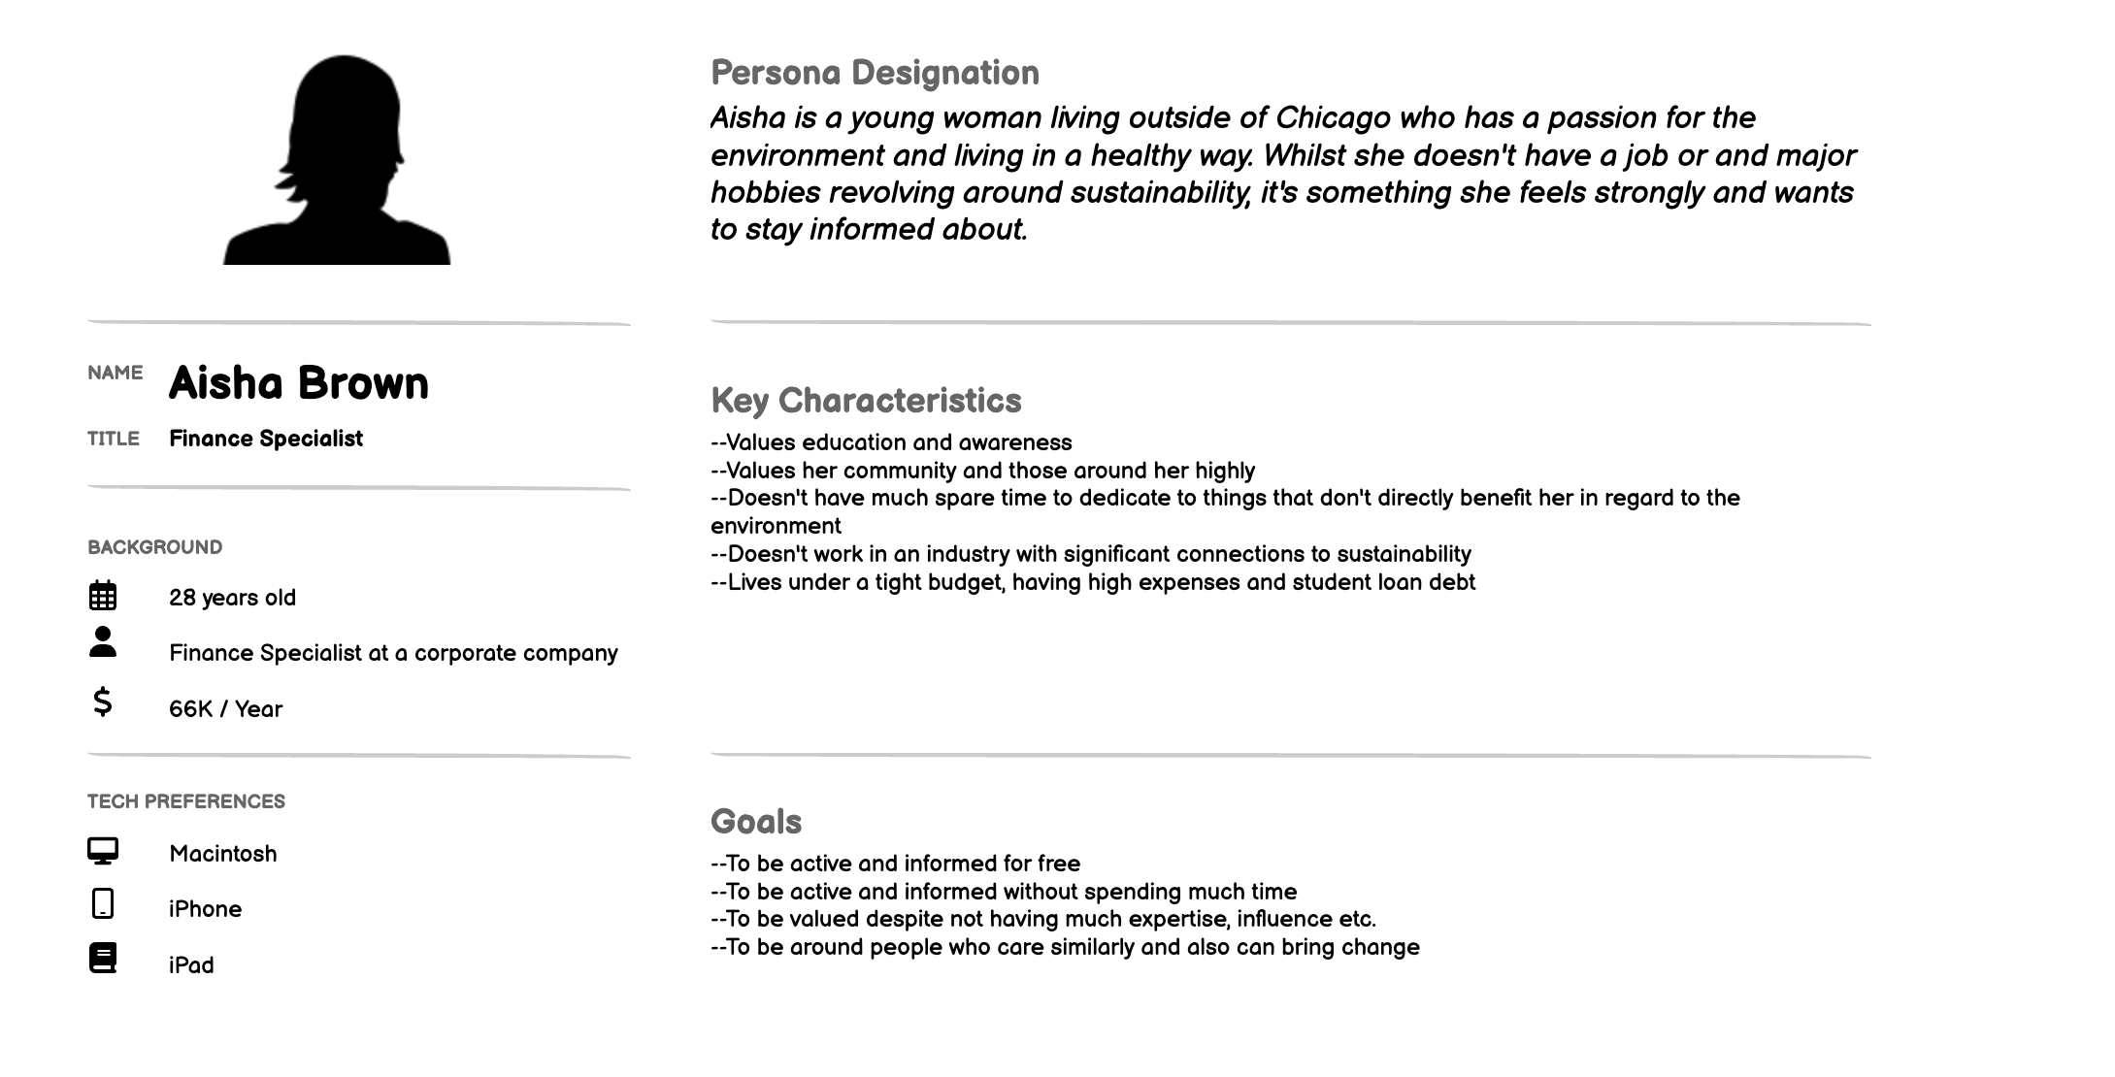
Albany
Notes:
Login (aishabrown12- 123) --> search businesses --> rates ekologic --> is hungry, so searches for mediterranean restaurant --> finds ali baba -> has good green rating, so wants to go there --> goes to map and finds ali baba --> done so logs out
Like many others in younger generations, she wants to better the environment and find more ecofriendly businesses

Slide 8
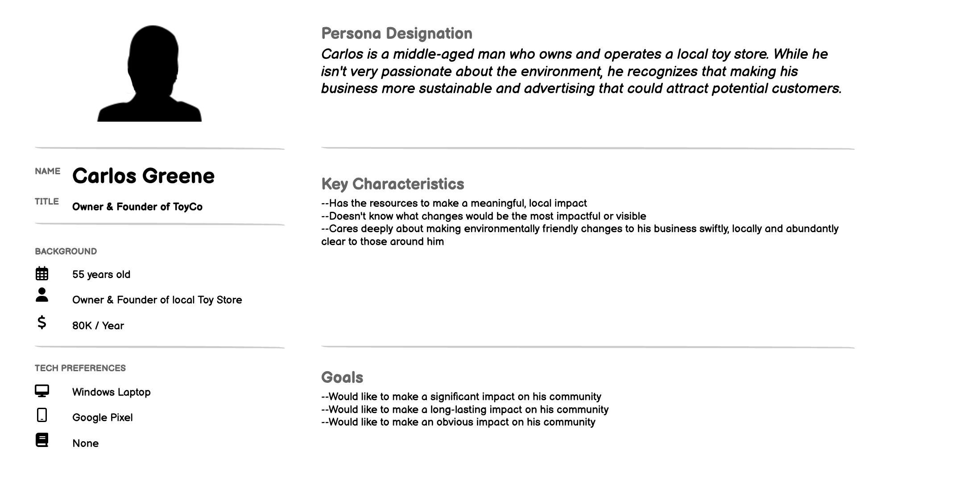

Slide 9
Thank You!
Questions?

